Slide 1
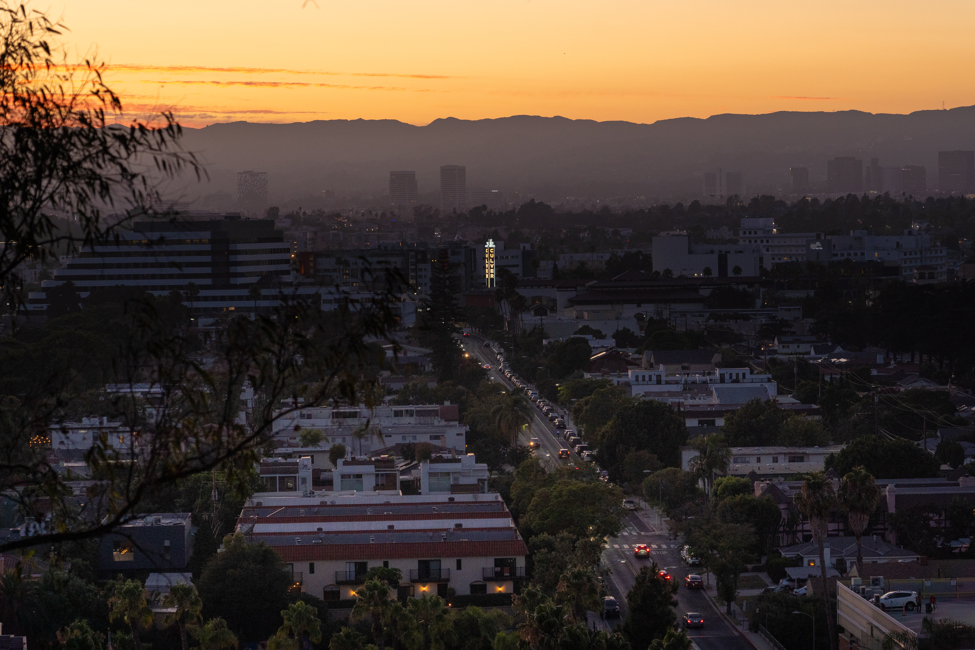
Police Sub Committee Meeting
October 28th ,2025
CITY OF CULVER CITY
Captain Andrew Bellante

Slide 2
What is the Racial Identity Profiling Act
Organizational Chart
    Assembly Bill 953
    Data Reported to California Department of Justice (DOJ)
    Reviewed by California State RIPA Board
UPDATE WITH DEPARTMENT PHOTOS

Slide 3
Culver City Daytime Population
Organizational Chart
    Culver City Daytime Population estimated to be approximately 300,000
    Sustainable Design Assessment Team (SDAT) Report
    ALPR Cameras- Over 19.3 Million Reads a Month
    Red Light Camera Data- 96% of vehicles NOT registered to CC
    92% of detentions in 2024 did NOT reside in Culver City
UPDATE WITH DEPARTMENT PHOTOS

Slide 4
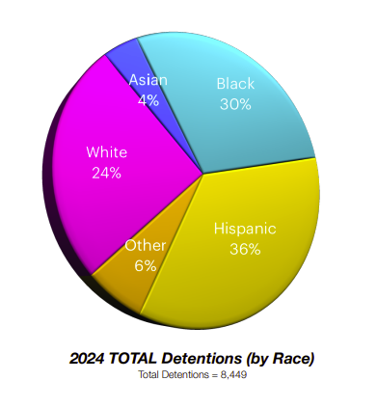
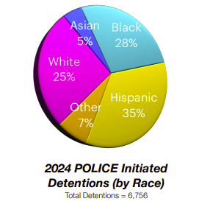
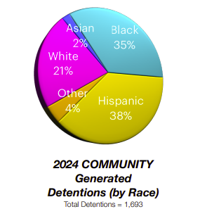
2024 RIPA Data
Organizational Chart
UPDATE WITH DEPARTMENT PHOTOS

Slide 5
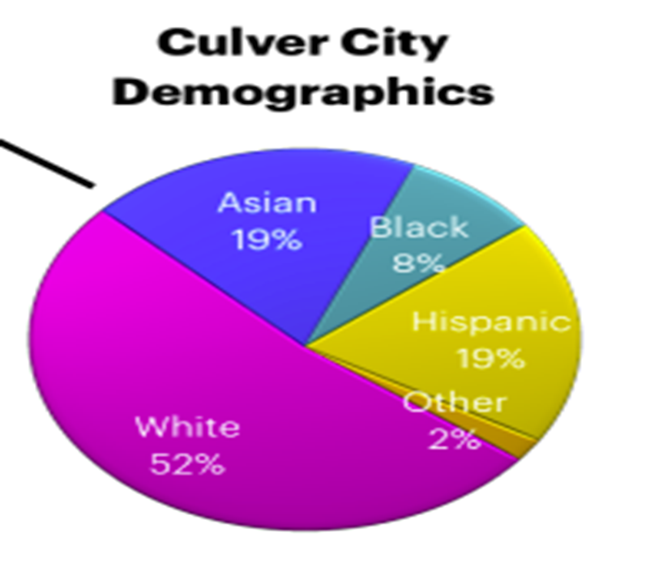
Culver City Residential Population
Organizational Chart
UPDATE WITH DEPARTMENT PHOTOS

Slide 6
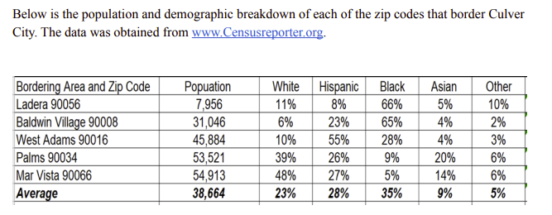
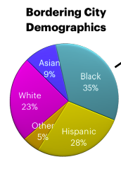

Benchmarking Technique #1: Bordering Regions
Organizational Chart
UPDATE WITH DEPARTMENT PHOTOS

Slide 7
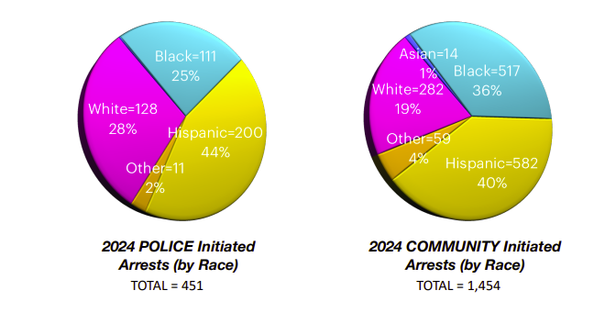
Benchmarking Technique #2: Arrest Data
Organizational Chart
UPDATE WITH DEPARTMENT PHOTOS

Slide 8
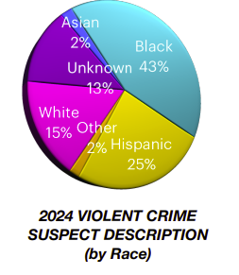
Benchmarking Technique #3: Violent Crime Data
Organizational Chart
UPDATE WITH DEPARTMENT PHOTOS

Slide 9
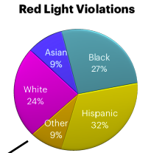
Benchmarking Technique #4: Red Light Camera Data
Organizational Chart
UPDATE WITH DEPARTMENT PHOTOS

Slide 10
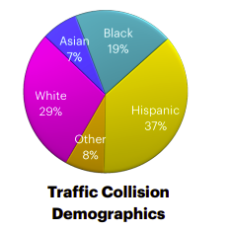
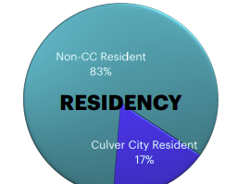
Benchmarking Technique #5: Traffic Collision Data
Organizational Chart
UPDATE WITH DEPARTMENT PHOTOS

Slide 11
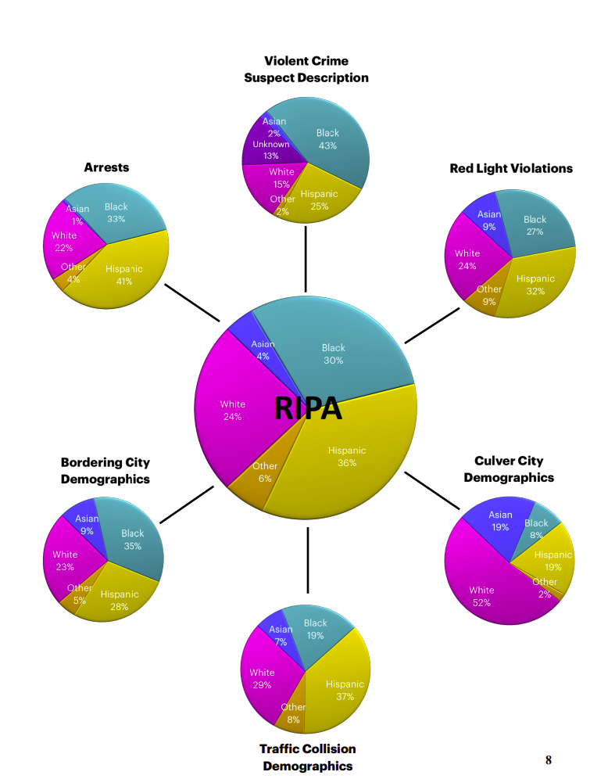
Executive Summary
Organizational Chart
UPDATE WITH DEPARTMENT PHOTOS

