Slide 1
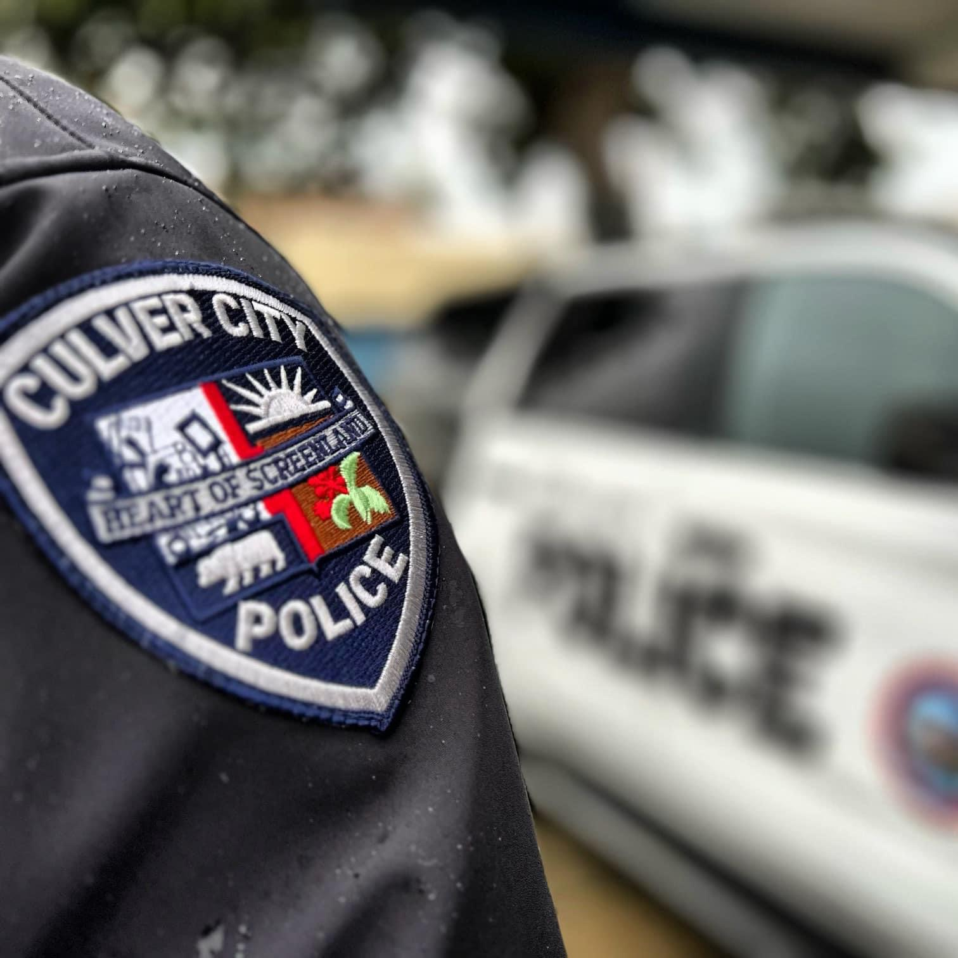
CCPD’s Mutual Aid Program Presentation
Captain Luis Martinez
July 9, 2025

Slide 2
What is mutual aid?
Agreements between law enforcement agencies to assist with emergencies
CCPD is a part of Mutual Aid Area A
Beverly Hills, Santa Monica, UCLA PD, LASD West Hollywood
Typically for planned / coordinated events
Main purpose to provide personnel, resource sharing, equipment, and expertise
Examples of usage:
Mass shootings, civil unrest, dignitary visits

Slide 3
MUTUAL AID PROTOCOLS
Standardized Emergency Management Systems (SEMS)
Different levels:
California, regions, counties, cities
Further broken into smaller regions
Chief of Police, or designee, makes the determination when to activate mutual aid
Additional resources can be requested from neighboring agencies, the region, the county, and if need be, the State

Slide 4
MUTUAL AID EXAMPLES
February 2024, Presidential visit by Joe Biden at the Julian Dixon Library
Provided mutual aid to the U.S. Secret Service
Assistance provided by Beverly Hills, Santa Monica, UCLA PD, and LASD West Hollywood
January 2025, Palisades fire
CCPD Staff responded to Santa Monica
Provided Mutual Aid for burglary/looter suppression
Approximately one-week

Slide 5
OUTSIDE AGENCY ASSISTANCE
Different than Mutual Aid
Typically occurs when an emergency request is made by an outside law enforcement agency
Example:
June 2025
Santa Monica PD Officer shot while attempting to arrest attempt murder suspect
CCPD personnel were requested and responded to assist with locating the suspect
July 2, 2025
Traffic collision in Fox Hills neighborhood involving CHP Officers
CCPD was requested and responded to provide assistance
Remained at location for extended period

Slide 6
IMMIGRATION ENFORCEMENT – Mutual aid
CCPD Policy 438
Culver City Resolution #2017-R025
Culver City Police do not assist in the enforcement of federal immigration law
CCPD personnel abide by Department policy and State Law (SB 54)
Consistently covered in daily briefings & roll call to ensure a firm understanding of the law

Slide 7
Potential ramifications of discontinuing mutual aid
Increased exposure to liability
Unable to provide adequate public safety services
Potential conflicts with the California Emergency Services Act
Erosion of public trust and confidence
Higher risk for injuries, property loss or fatalities
Loss of reciprocal support from neighboring cities
Strain on existing personnel and resources

Slide 8
Conclusion
Mutual Aid is vital for law enforcement agencies
Enables agencies to collaborate, pool resources, including personnel, to address incidents that exceed the capacity of a single agency
Continuing participation ensures strong regional cooperation, enhances public safety, and mitigates liability concerns

Slide 9
QUESTIONS?

