Slide 1
Bola wrap

Slide 2

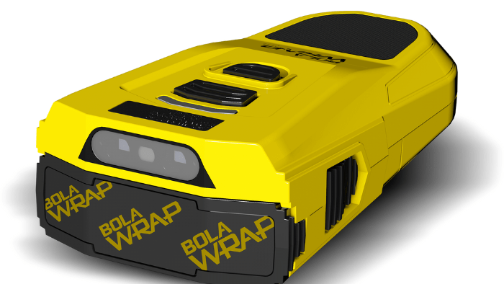
What is bola wrap
Bola Wrap is a state-of-the-art, non-lethal remote restraint device
avoids direct physical contact and minimizing injury risk for both officers and individuals
Deploys a Kevlar tether towards an individual from a distance, reducing the need for physical confrontation

Slide 3
How the Bola Wrap Works
Device Mechanism:
Deploys a 7.5-foot Kevlar cord at 640 feet per second
Cords have hooks on each end to wrap around a subject's legs
Range:
Effective range is between 10 and 25 feet
Activation:
  Activated by pressing a button on the device
  A green laser helps aim at the target area

Slide 4
Benefits of the Bola Wrap
Non-Lethal and Safe:
  Reduces the need for physical confrontation
  Minimizes risk of injury to both officers and subjects
Effective Restraint:
  Quickly immobilizes individuals without causing significant harm
De-escalation Tool:
  Useful in managing non-compliant individuals safely
  Can be used in situations where traditional methods may escalate tension

Slide 5
Situations where Bola could be utilized to de-escalate situations
Emotionally Disturbed Persons (EDP)
Passively resistant and non-compliant subjects
Mildly aggressive non-compliant subjects
Suicidal subjects/Persons in crisis
Subjects under the influence of alcohol and drugs
Armed (not with a firearm), non-assaultive, non-compliant, non-mobile

Slide 6
Considerations and limitations
Training:
Each Officer must undergo a four-hour training block
Training will consist of a policy overview and hands on deployment
Situational Awareness:
Not suitable for all situations, such as an armed confrontation

Slide 7
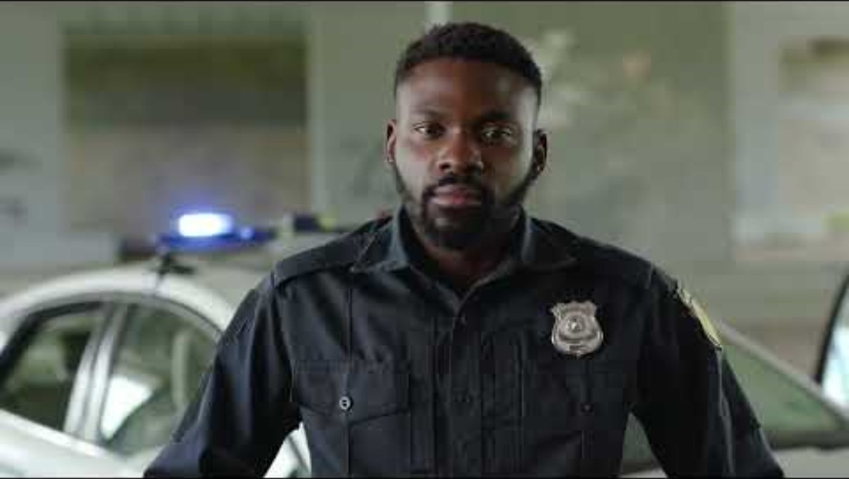

Slide 8
Cost
Bola Wrap Device: $1,299 Each
Kevlar rope: $39 for 6 deployments

Slide 9
Human Rights Organizations
“Anytime you can have a more humane response to someone in crisis, it’s not only good for the department, it’s good for society.” Redditt Hudson
Advocate for Human Rights, Advocate for Criminal Justice Reform, Co-founder of the National Coalition of Law Enforcement Officers for Justice, Reform, and Accountability, and NAACP Regional Field Director

Slide 10
Neighboring agencies using bola wrap
Hawthorne Police Department
Using Bola for the past year
had 20 deployments
one minor injury requiring a band-aid
El Segundo Police Department
Using Bola for five years
Had zero Deployments

Slide 11
Group Discussion
Thoughts regarding Bola Wrap Policy
What are your Concerns
What Questions do you have

